Slide 1
SUPPLY CHAIN & SALES PERFORMANCE Analysis
SHIFANA NAZAR

Slide 2
PROBLEM STATEMENT
A global retail company, DataCo, is facing challenges in managing its supply chain efficiency, delivery performance, and overall profitability. The company operates across multiple regions, markets, and product categories, serving a diverse customer base.

Slide 3
PROJECT & STRATEGY:
DEFINITION
The project analyzes business performance using Power BI by cleaning data, identifying KPIs, and building interactive dashboards for insights.

Slide 4
DASHBOARDS
01
02
03
04
Executive Dashboard
Supply Chain Dashboard
Sales & Product Dashboard
Customer & Geography Dashboard

Slide 5
01
Executive Dashboard
This dashboard gives a quick overview of overall business performance, including sales, profit, and delivery status.

Slide 6



Key Performance Indicators (KPIs)
Late Delivery %
Total Sales
Total Profit
54.8%
$ 36.8M
$ 4.0M

Slide 7
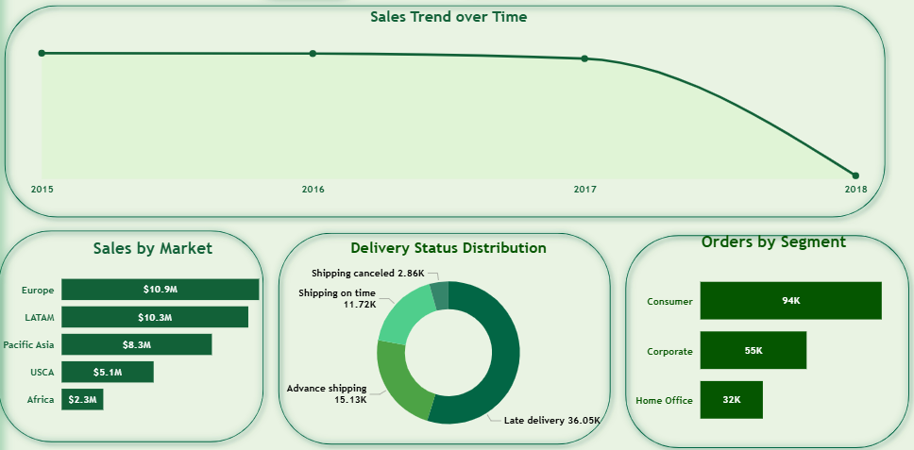
INSIGHTS :
Sales remained relatively stable from 2015 to 2017 but dropped significantly in 2018, indicating a potential decline in demand or operational issues.
The Consumer Segment contributes the highest number of orders, making it the key customer group

Slide 8
02
Supply Chain Dashboard
This dashboard focuses on supply chain performance, highlighting delivery times, delays, and shipping efficiency to identify operational issues.

Slide 9




Key Performance Indicators (KPIs)
Average Delivery
Days
Late Orders Count
3.5
Average Delivery Delay
99K
Average Sheduled Days
0.57
2.9

Slide 10
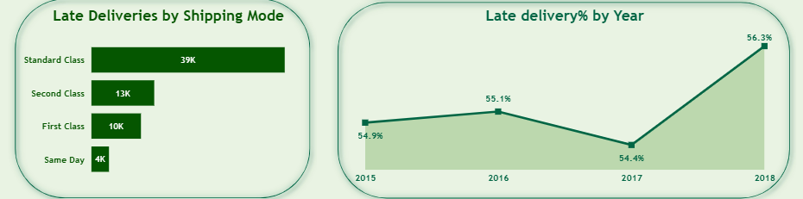
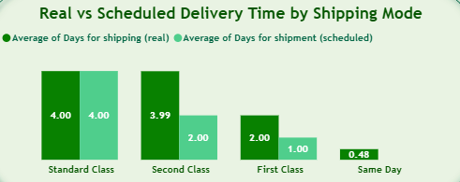
INSIGHTS :
Standard Class shipping has the highest number of late deliveries, making it the biggest contributor to delays
There is a clear gap between scheduled and actual delivery time, especially in Standard and Second Class shipping.
Late delivery percentage has increased in 2018, indicating worsening logistics performance.

Slide 11
03
Sales and Product Dashboard
This dashboard analyzes sales performance and product trends, highlighting key revenue drivers and the impact of discounts on profitability.

Slide 12


Key Performance Indicators (KPIs)
Average Discount
Average Profit Per Order
10.2%
$21.97

Slide 13
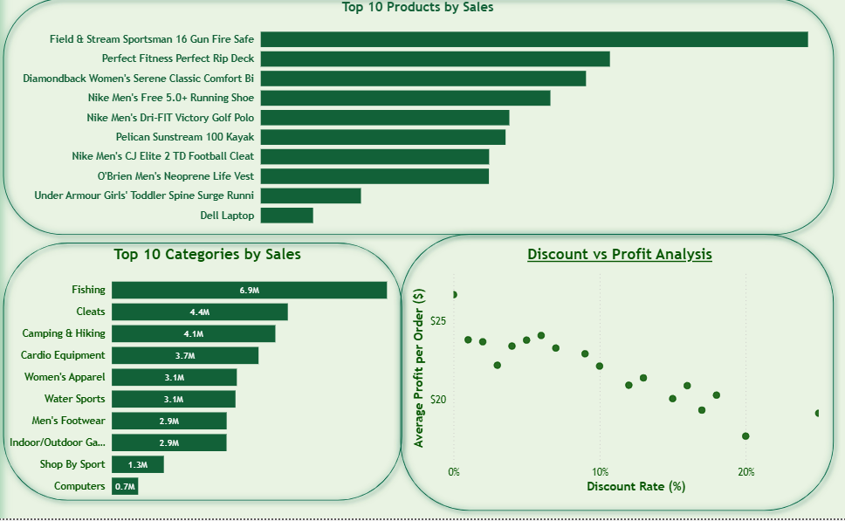
INSIGHTS :
A small number of products and categories contribute to the majority of sales, showing a concentration of revenue in top-performing items
The Fishing and Cleats categories generate the highest sales, making them key revenue drivers
There is a negative relationship between discount and profit, where higher discounts lead to lower profit per order.
This suggests that aggressive discounting strategies are reducing profitability.

Slide 14
04
Customer & Geography Dashboard
This dashboard provides insights into customer distribution and geographic sales performance, helping identify key markets and customer segments.

Slide 15


Key Performance Indicators (KPIs)
Total Customers
Average Sales Per Customer
21K
$183.11

Slide 16
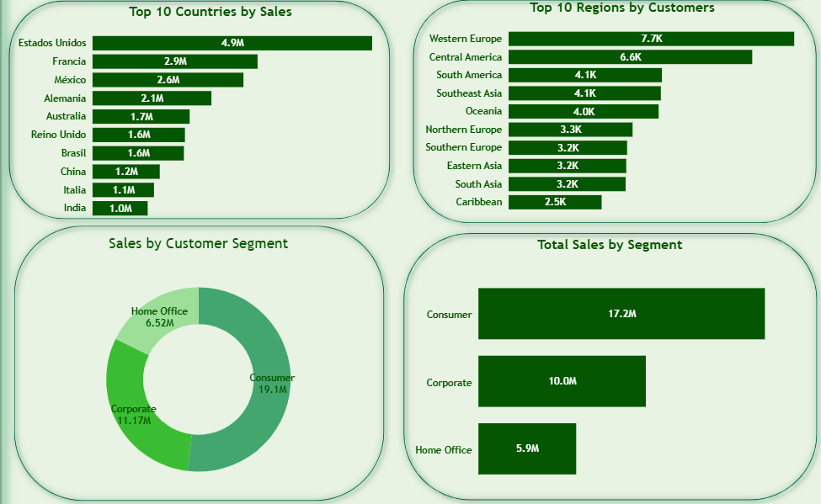
INSIGHTS :
The United States (Estados Unidos) is the leading country by a wide margin, contributing $4.9M in sales
Western Europe and Central America are the strongest regions by customer count, hosting 7.7K and 6.6K customers respectively.
The Consumer segment not only has the highest total sales ($19.1M) but also the highest average sales per customer ($17.2M)

Slide 17
Recommendations :
Fix Logistics Delays: Prioritize fixing the 54.8% late delivery rate by auditing Standard Class shipping, which accounts for the most delays
Cap Discounts: Limit discount rates to under 15% to protect the $21.97 average profit per order and stop the margin decline.
Target High-Value Markets: Focus marketing and inventory on Estados Unidos and the Consumer segment, as they represent the highest sales volume and customer value.
Align Delivery Timelines: Update "Scheduled" shipping days to match "Real" delivery times to manage customer expectations and improve satisfaction.
Reverse Sales Decline: Investigate the sharp drop in sales between 2017 and 2018 by launching a re-engagement campaign for the customers in the Consumer segment.

Slide 18
THANK YOU

